Slide 1

INTERIOR DESIGN PROPOSAL by SUUM

Slide 2
INTERIOR DESIGN PROPOSAL
CONTENTS
01.
Marketing Research 3
02.
Design Concept 4
03.
Interior Design 5~21
Zoning Plan
Floor Plan
Elevation
Facade View
Perspective View
Column Display
Furniture

Slide 3

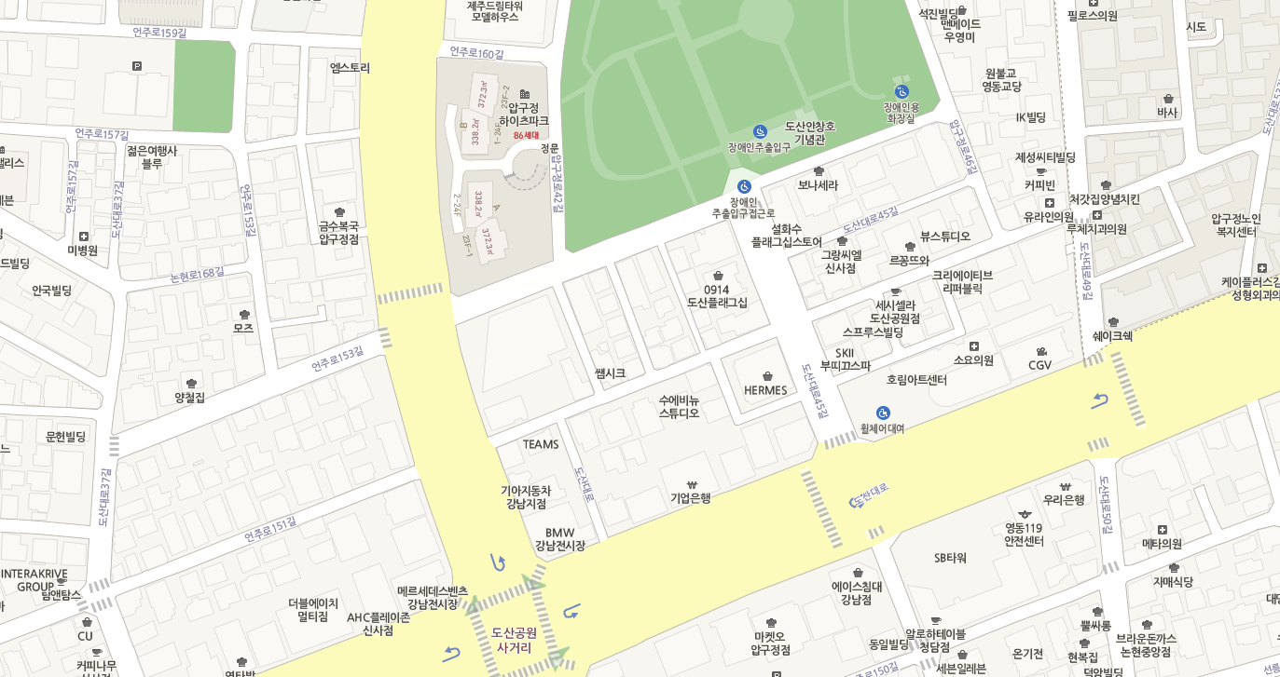
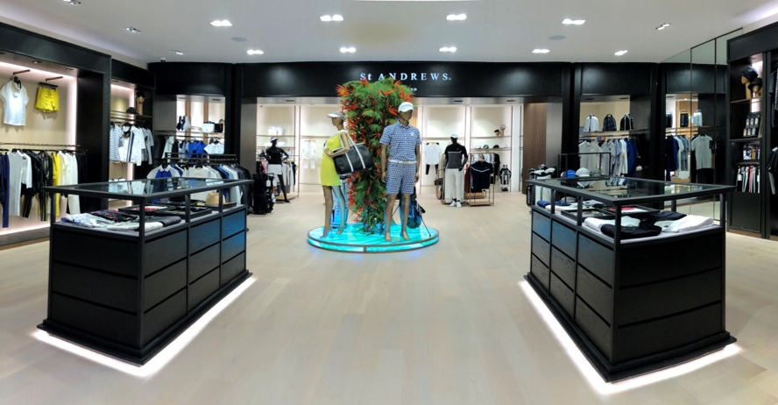


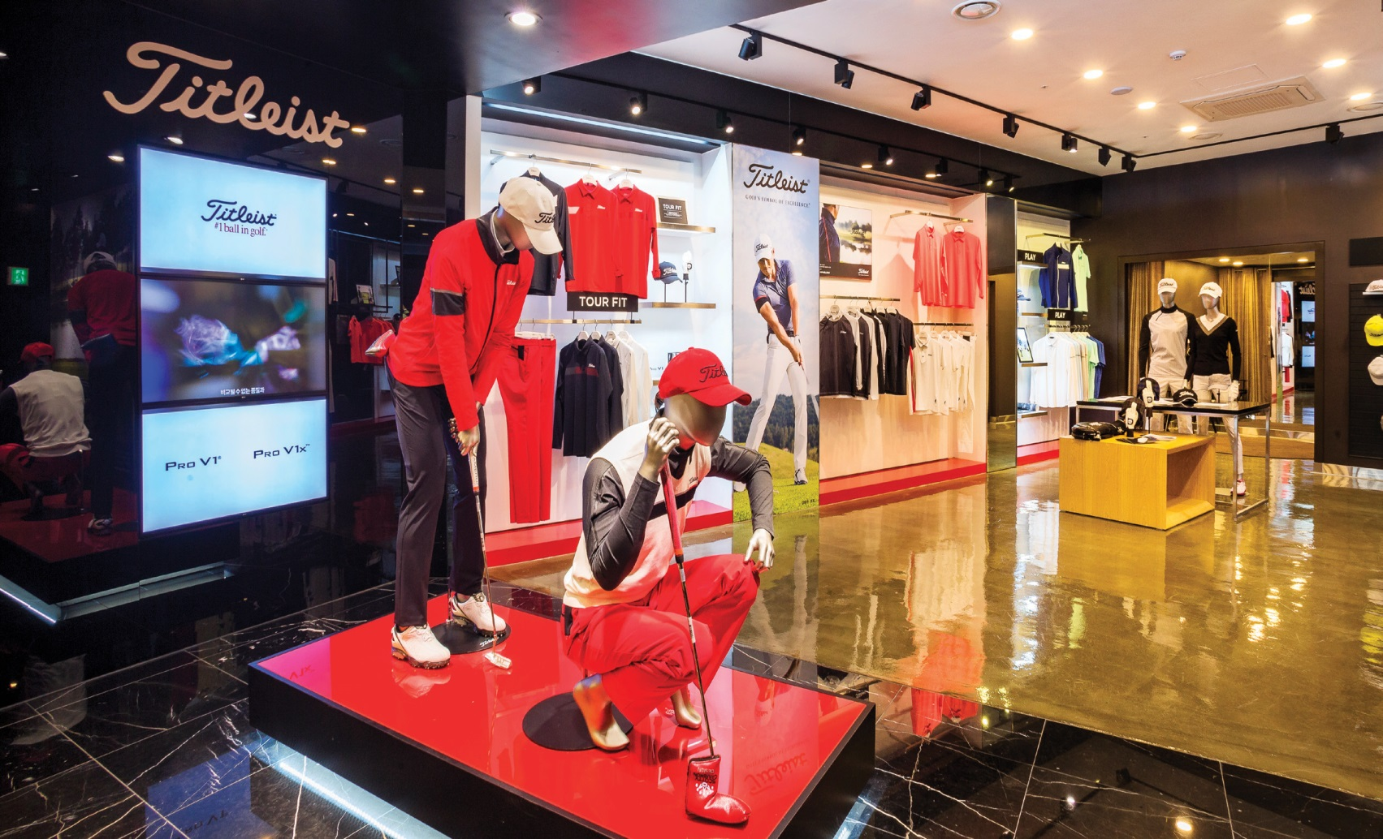
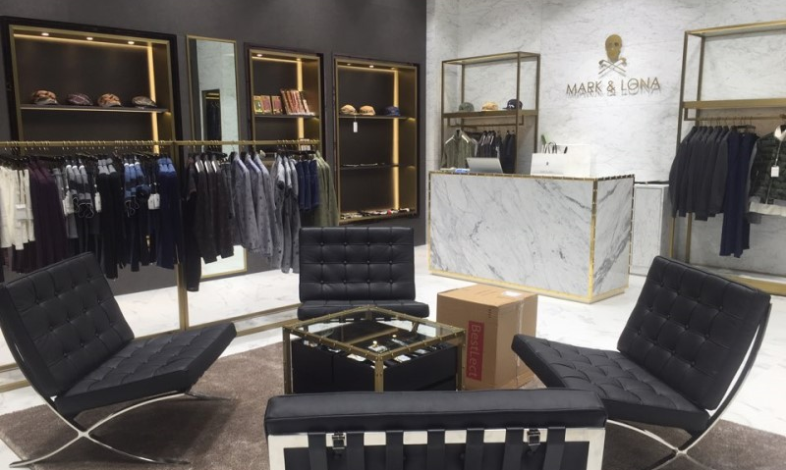
INTERIOR DESIGN PROPOSAL
01.
Marketing Research
RENOMA
Titleist
NIKE GOLF
Castelbajac
St ANDREWS
Munsingwear
TaylorMade
Callaway
MARK & LONA
스코틀랜드 감성의 BLACK & WHITE MODERN_타 브랜드와의 차별성 부족
BLACK & RED_고급스러움, 독창성 부족
LUXURY & UNIQUE_개성이 강해서 다양한 연령층 소화 한계

Slide 4
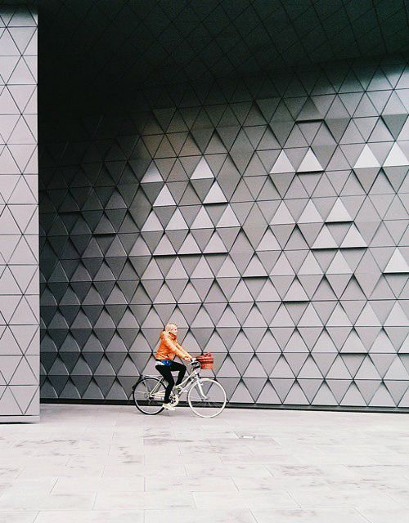
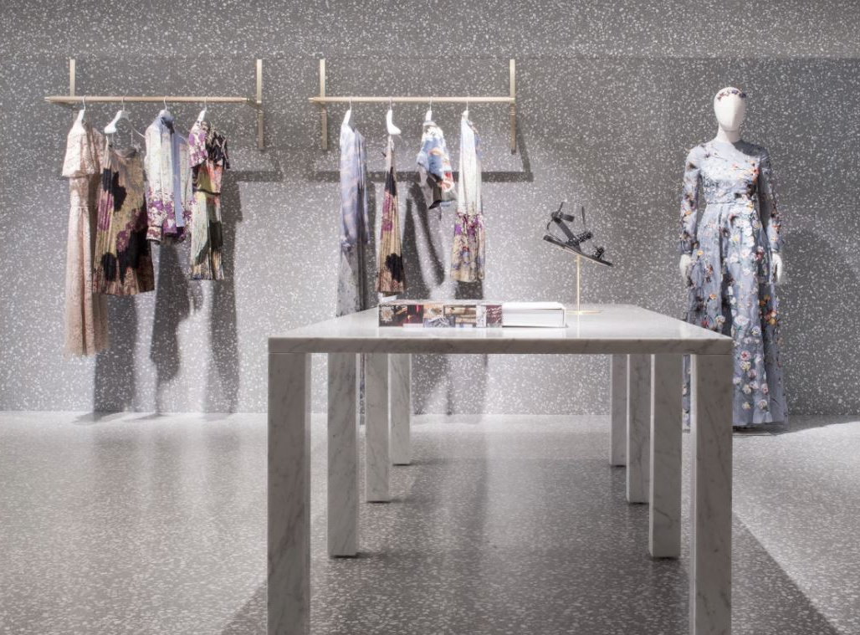


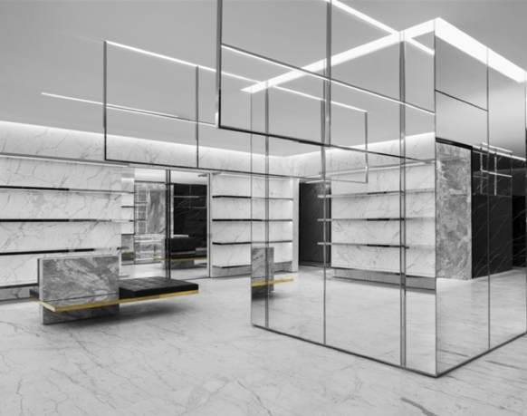
INTERIOR DESIGN PROPOSAL
02.
Design Concept
Luxury, Modern, Chic, 그 이상
·TONE & MANNER
·CONCEPT IMAGE

Slide 5
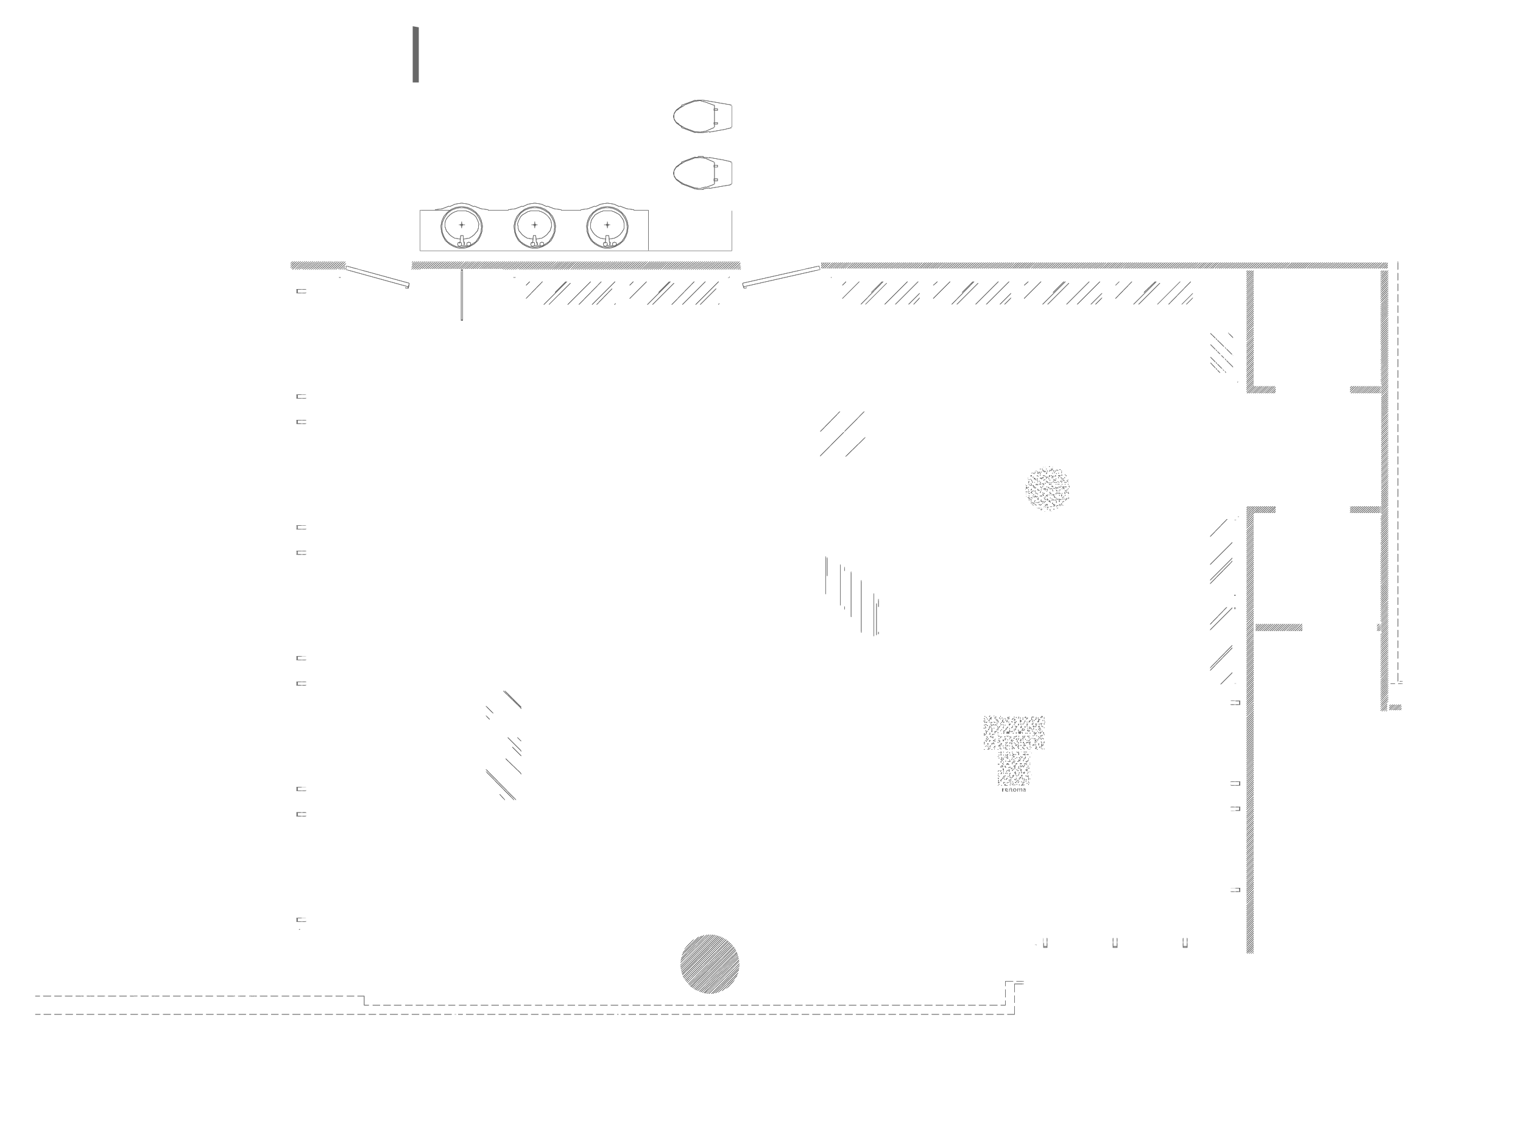
INTERIOR DESIGN PROPOSAL
03.
Interior Design Zoning Plan
Entrance
Parking area
Rest room
Mirror
Logo
V.P
Visual
Hypervsn
Visual
Main wall
Fitting room
ACC
Counter
Mirror
휴게공간
ACC
Fitting room
Sub wall
V,P Zone
Monitor
Storage
Sub wall
Show window
History or
concept
Logo
Show window
Main
Entrance

Slide 6
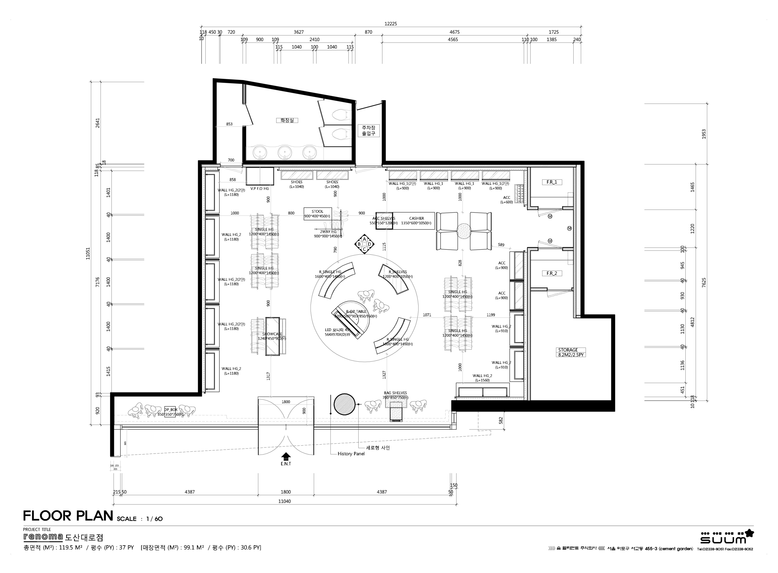
INTERIOR DESIGN PROPOSAL
03.
Interior Design Floor Plan

Slide 7
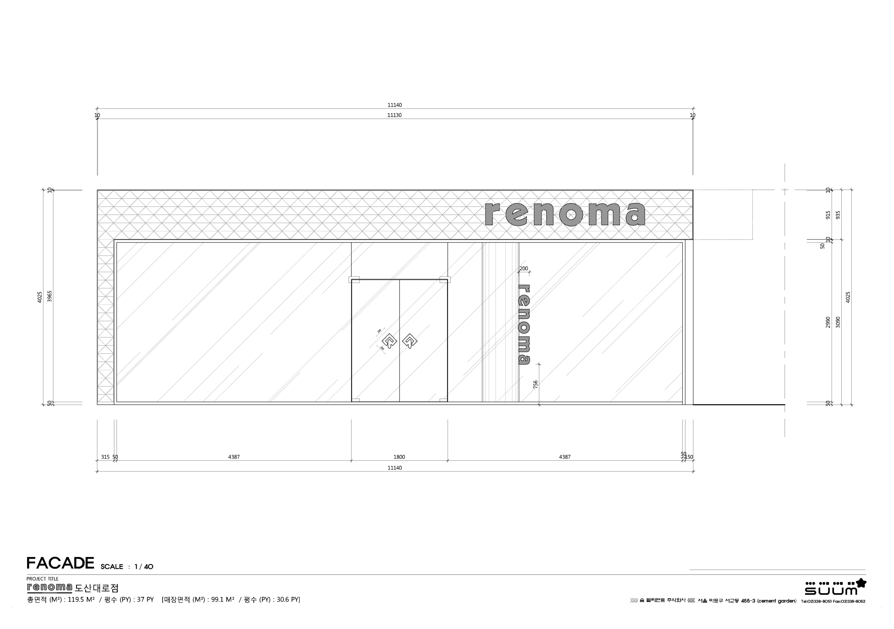
INTERIOR DESIGN PROPOSAL
03.
Interior Design Elevation _ Facade

Slide 8
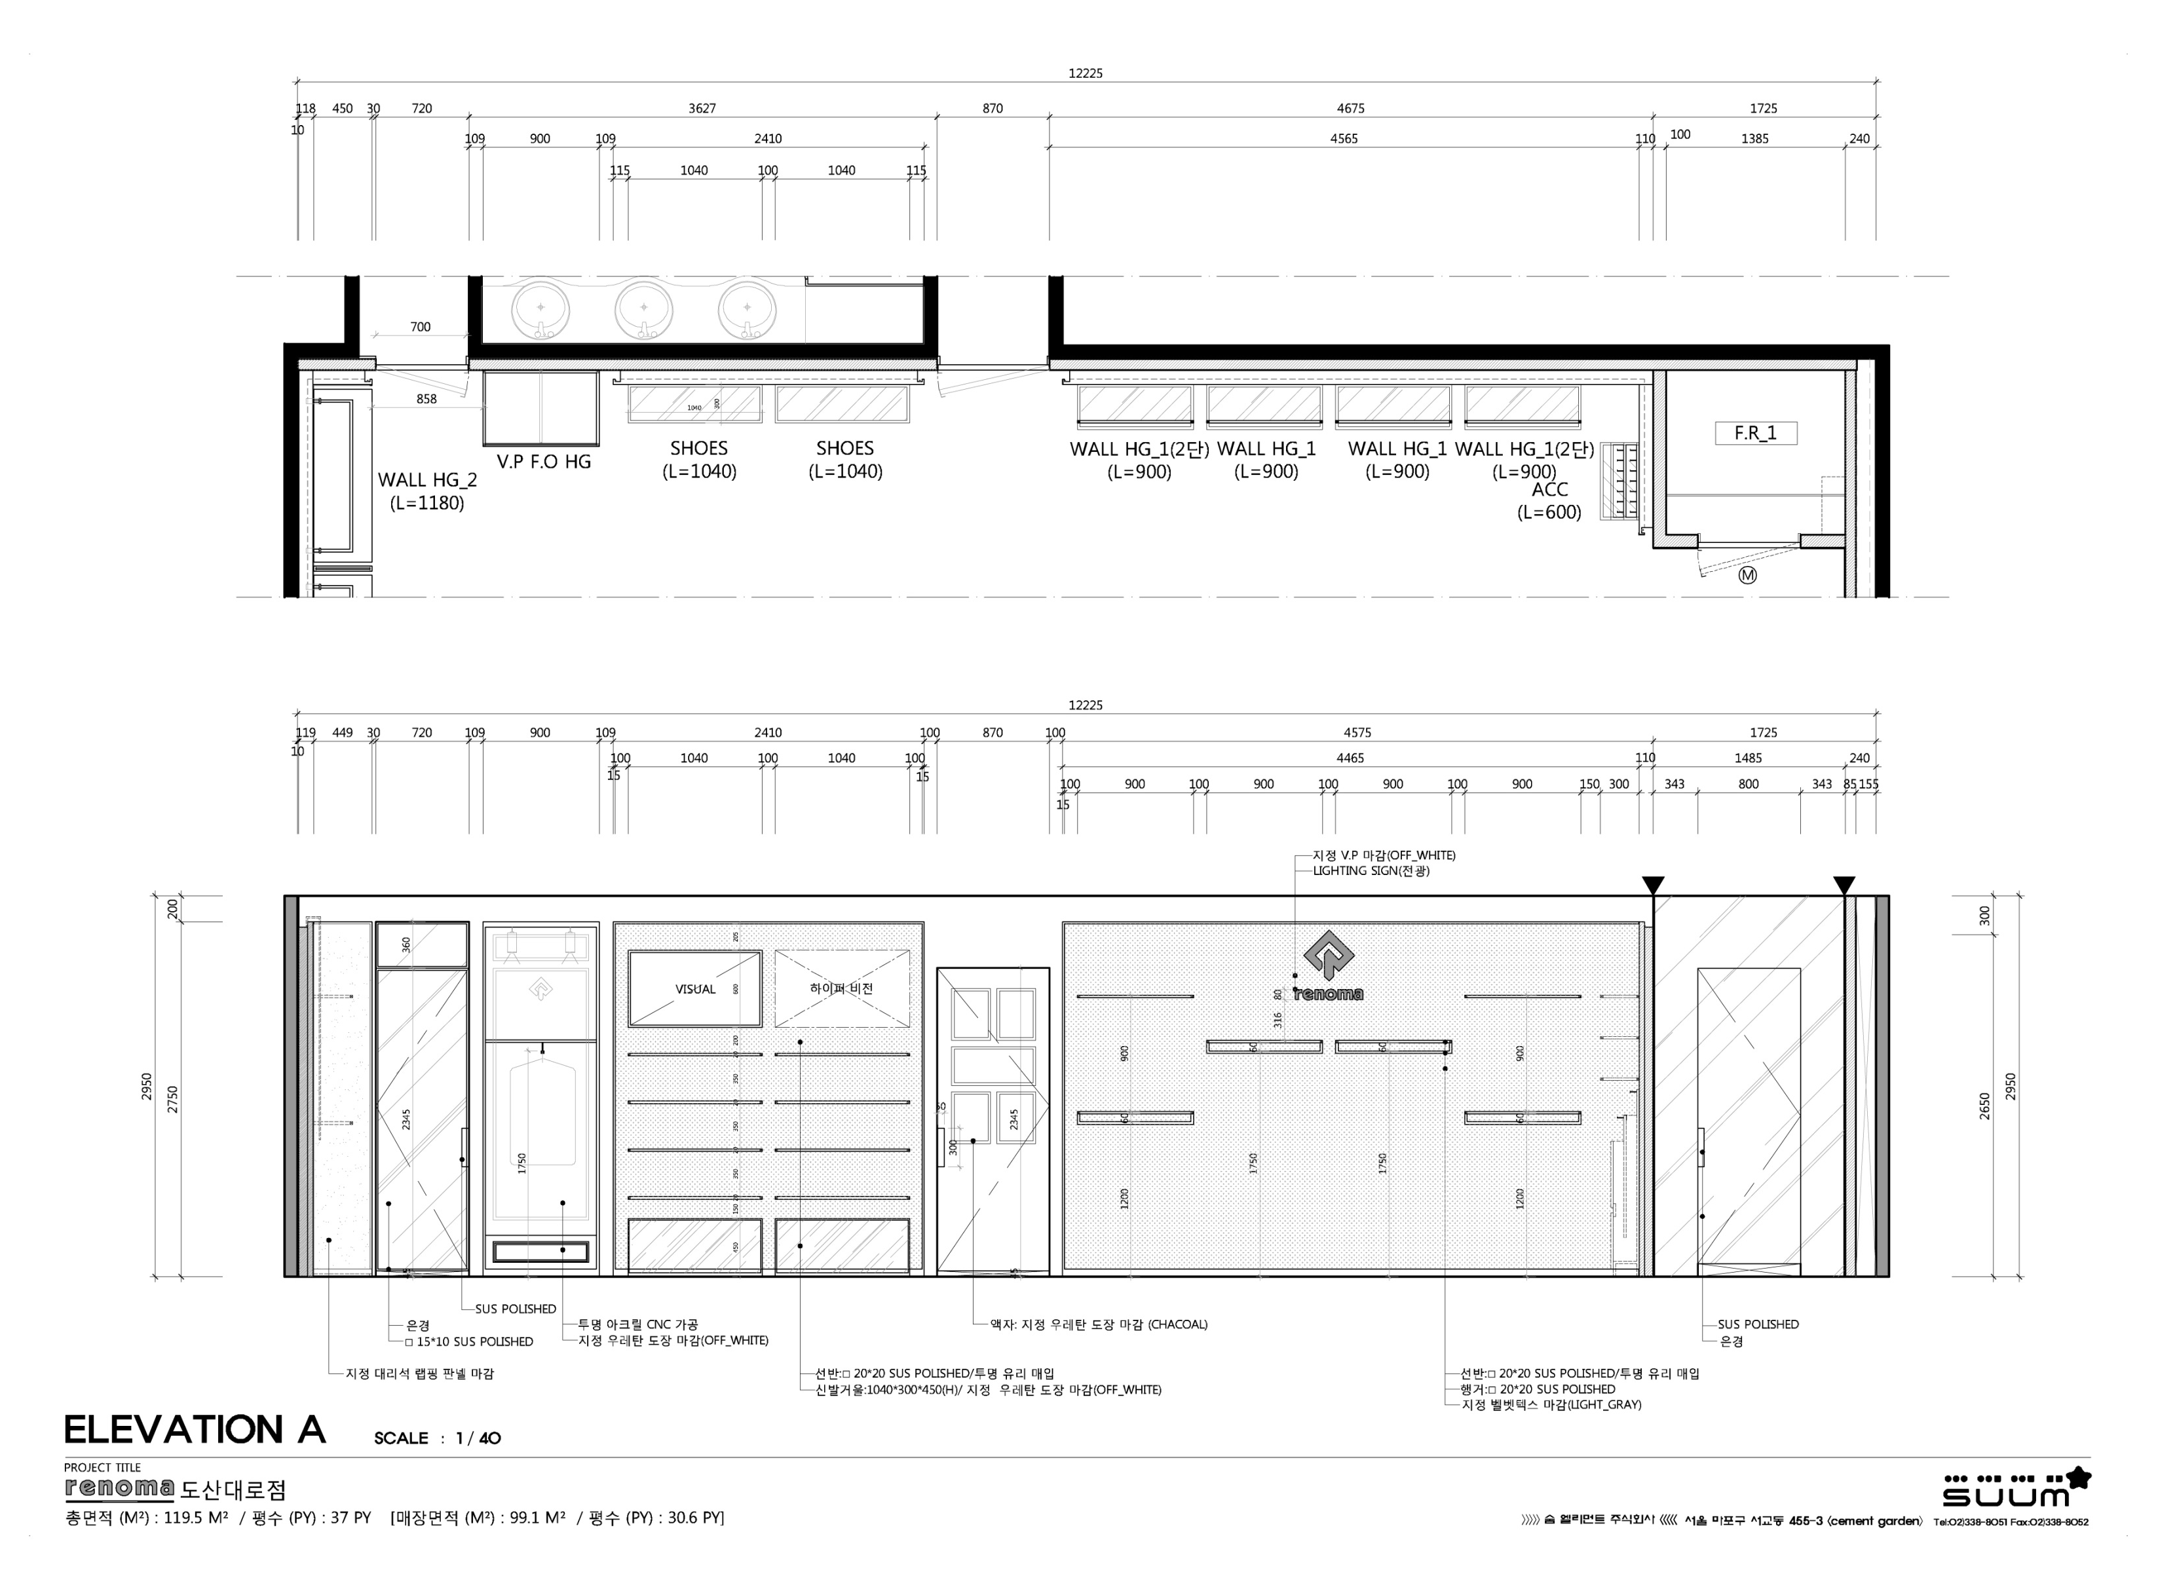
INTERIOR DESIGN PROPOSAL
03.
Interior Design Elevation _ A

Slide 9
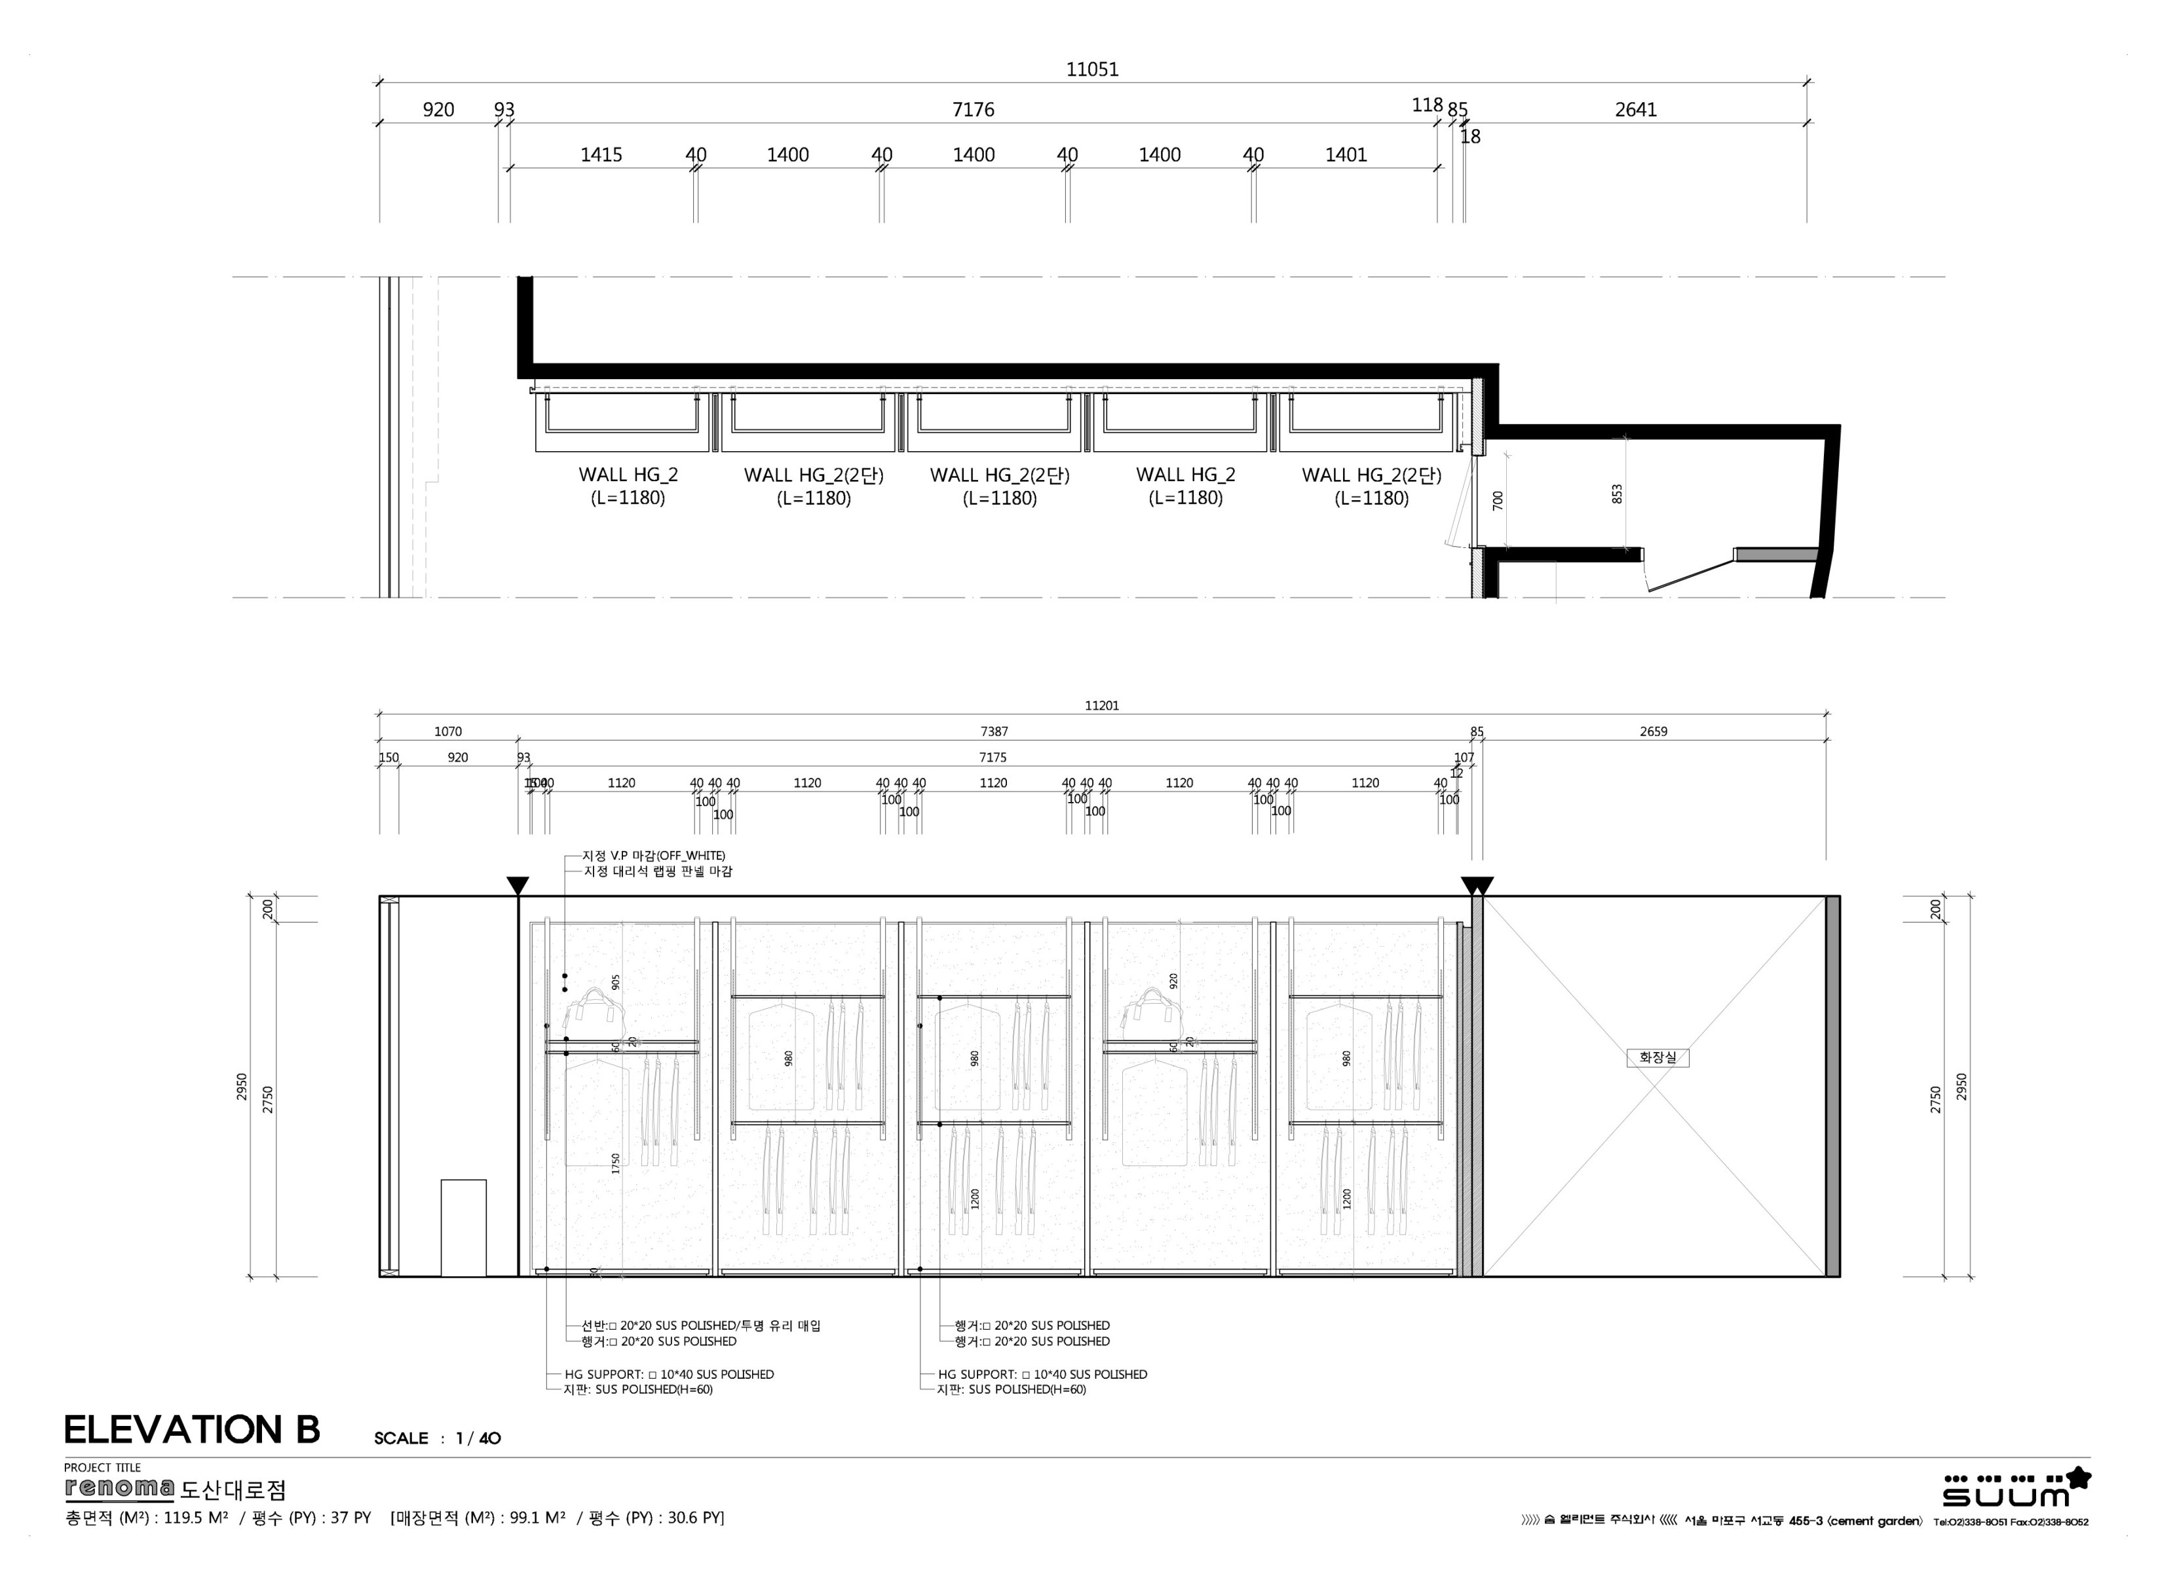
INTERIOR DESIGN PROPOSAL
03.
Interior Design Elevation _ B

Slide 10
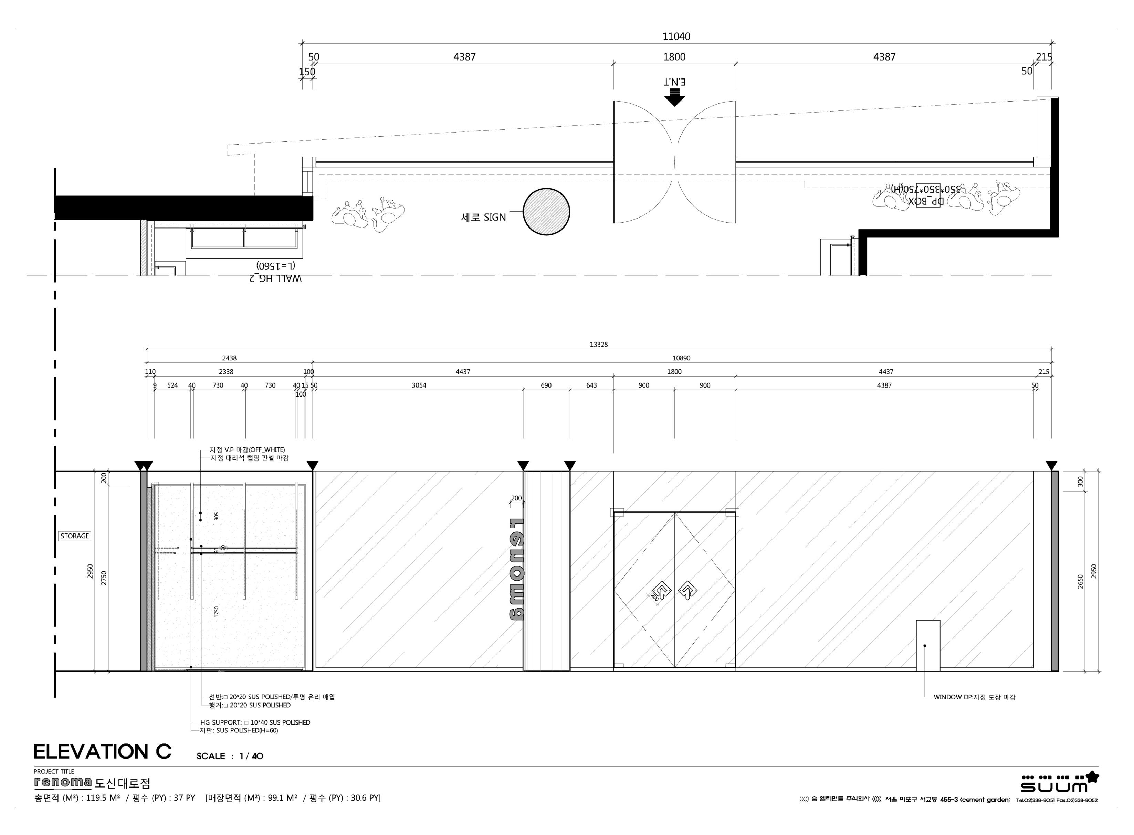
INTERIOR DESIGN PROPOSAL
03.
Interior Design Elevation _ C

Slide 11
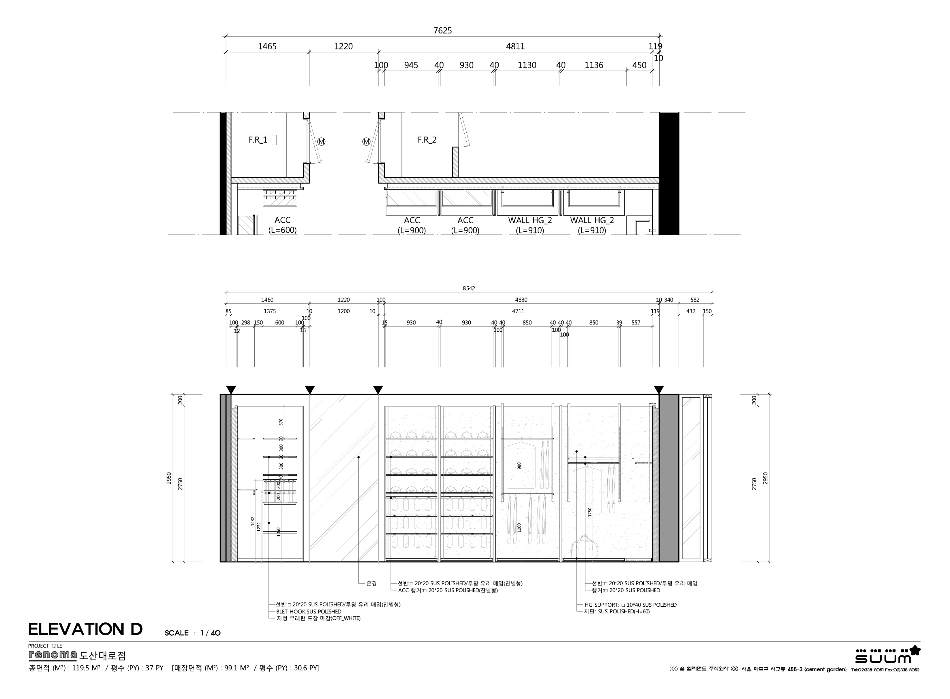
INTERIOR DESIGN PROPOSAL
03.
Interior Design Elevation _ D

Slide 12
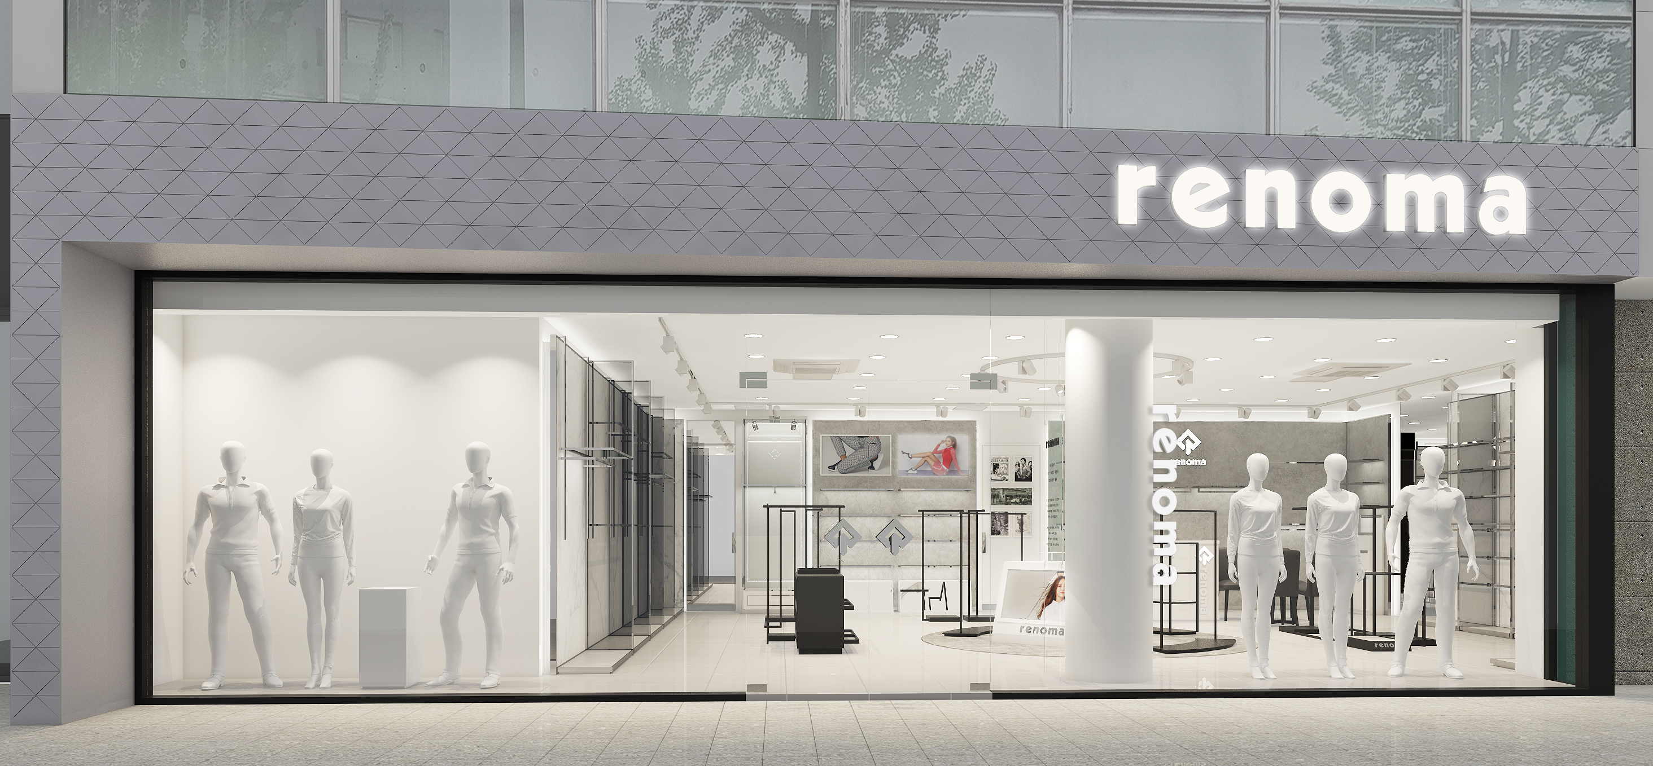
INTERIOR DESIGN PROPOSAL
03.
Interior Design Facade View

Slide 13
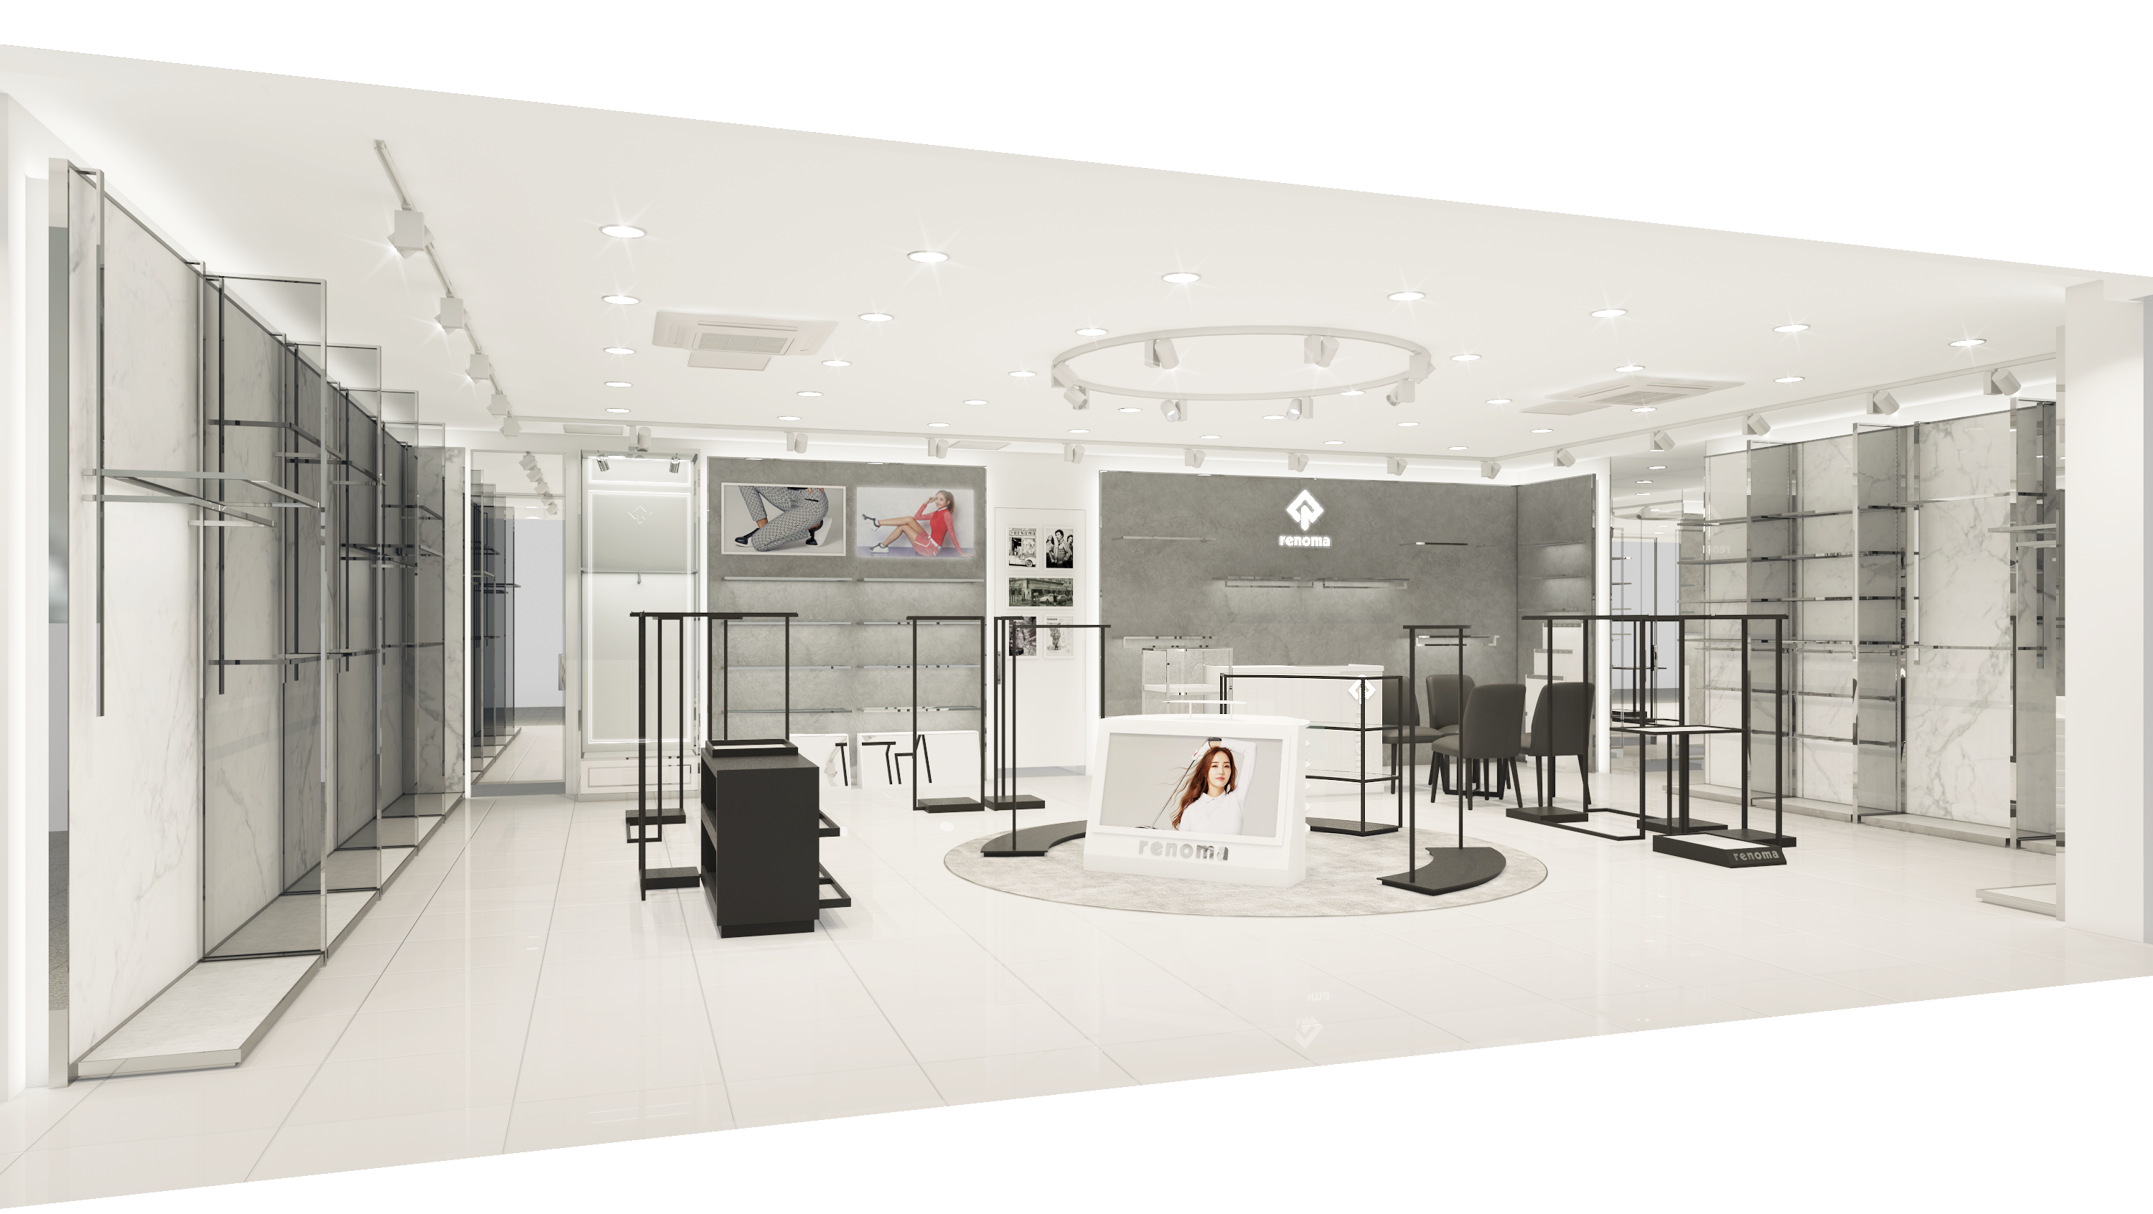
INTERIOR DESIGN PROPOSAL
03.
Interior Design Perspective _ Front View

Slide 14
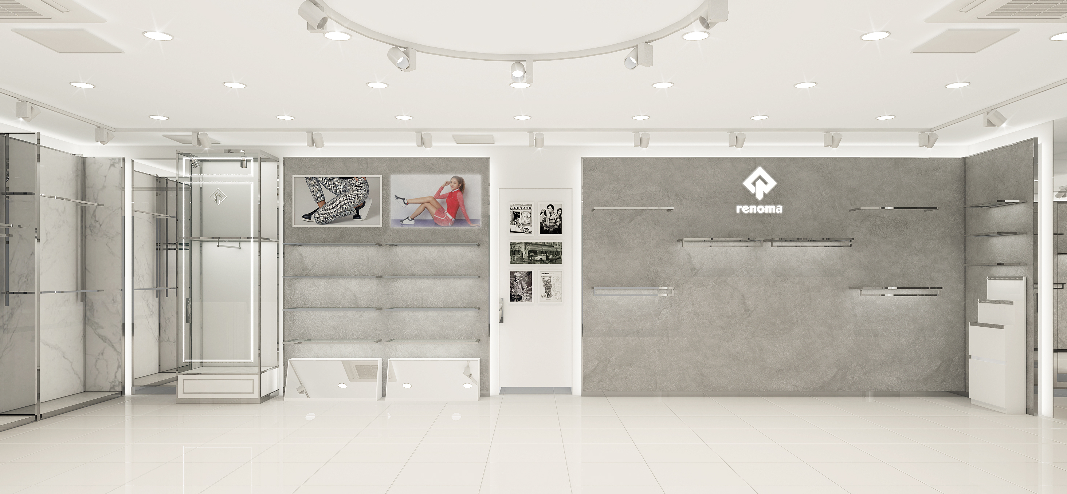
INTERIOR DESIGN PROPOSAL
03.
Interior Design Perspective _ Front View

Slide 15
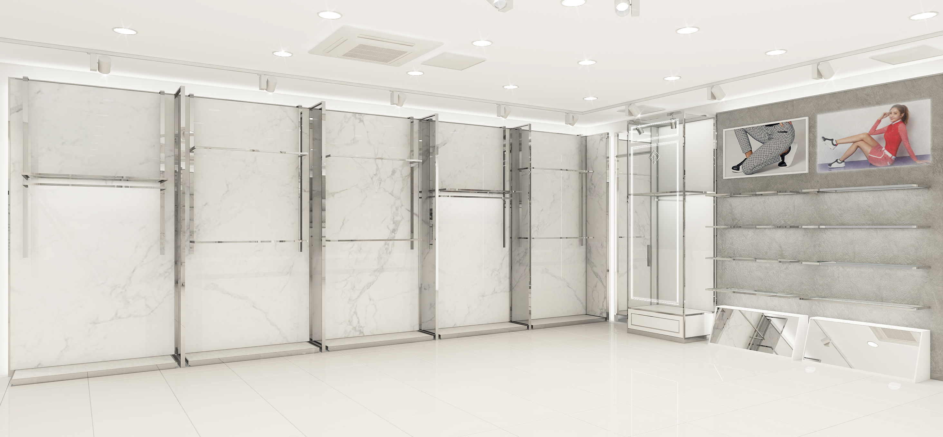
INTERIOR DESIGN PROPOSAL
03.
Interior Design Perspective _ Left View

Slide 16
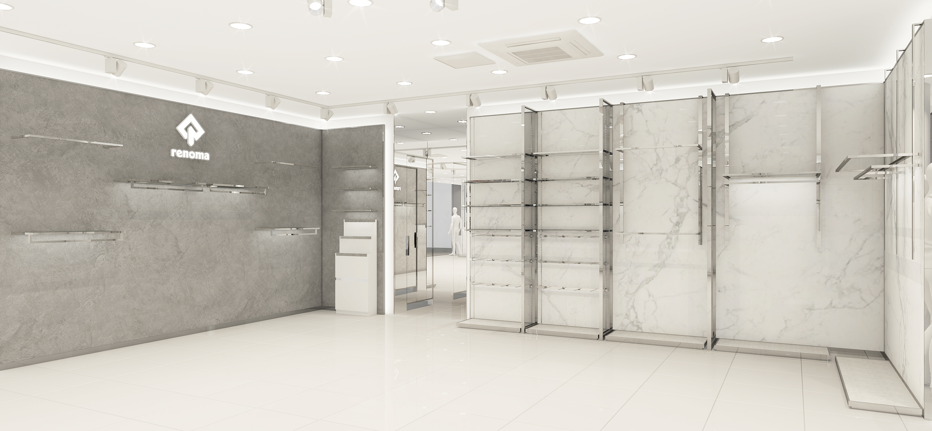
INTERIOR DESIGN PROPOSAL
03.
Interior Design Perspective _ Right View

Slide 17
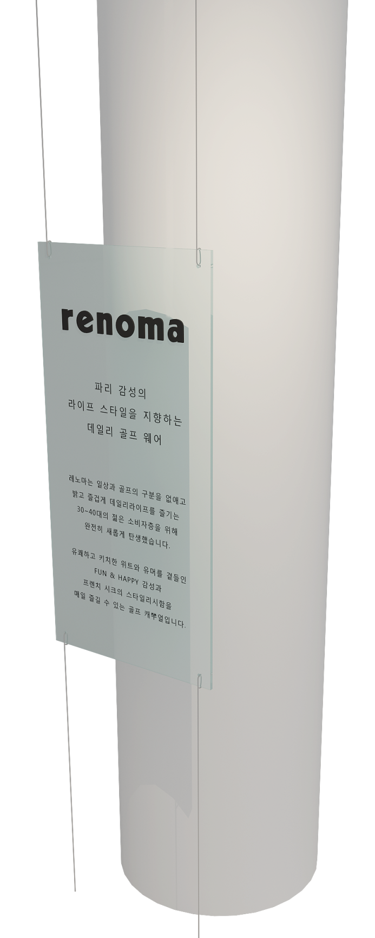
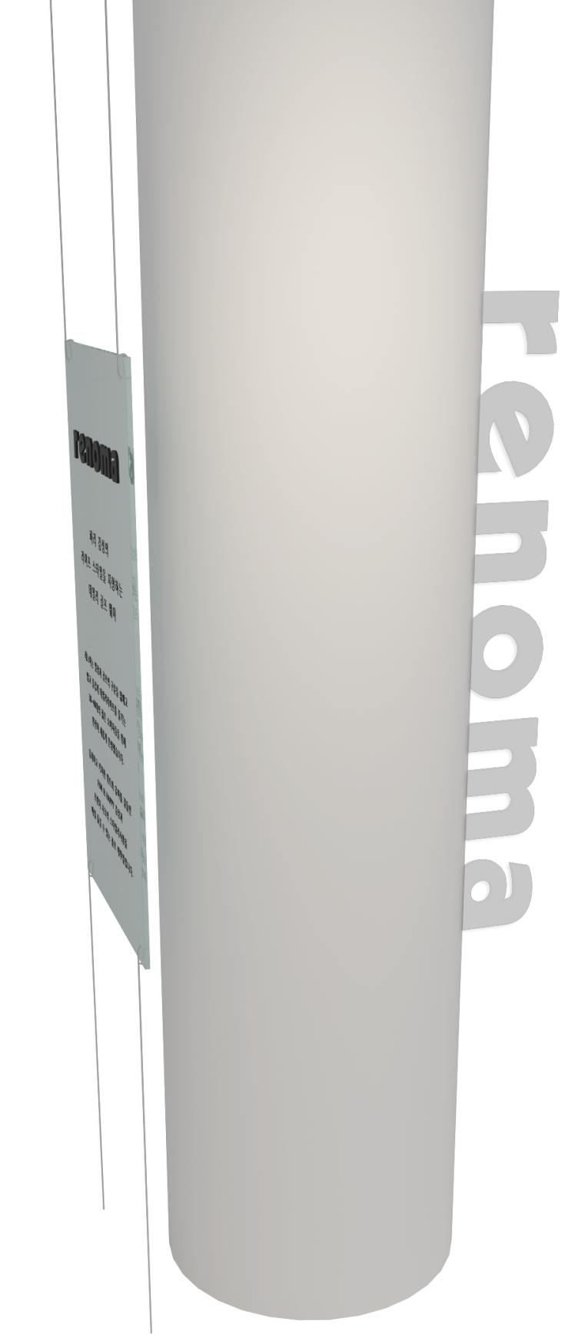
INTERIOR DESIGN PROPOSAL
03.
Interior Design Column Display
History or Concept Display
Logo Display

Slide 18

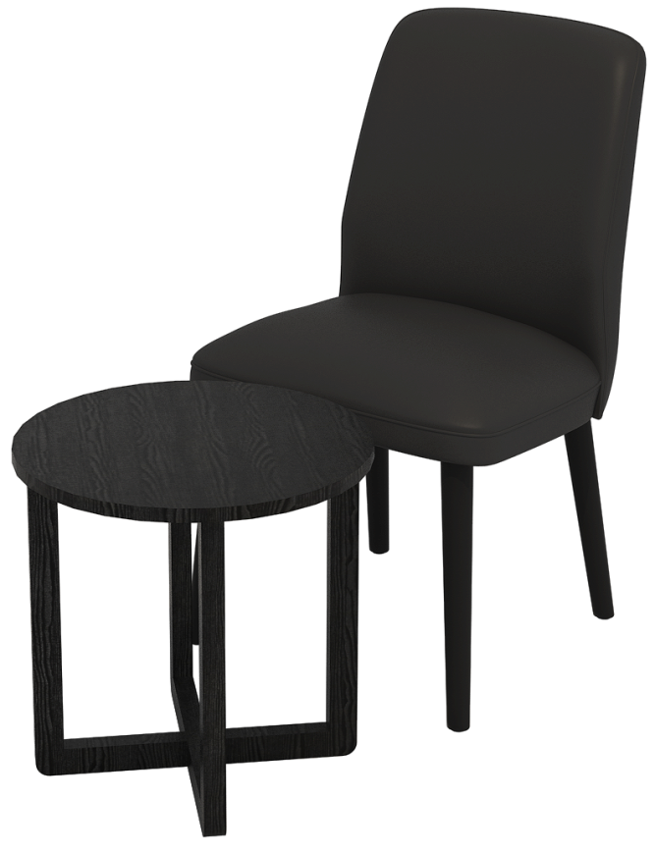
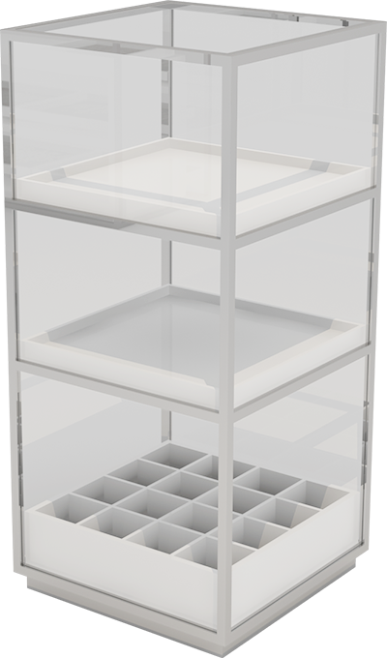
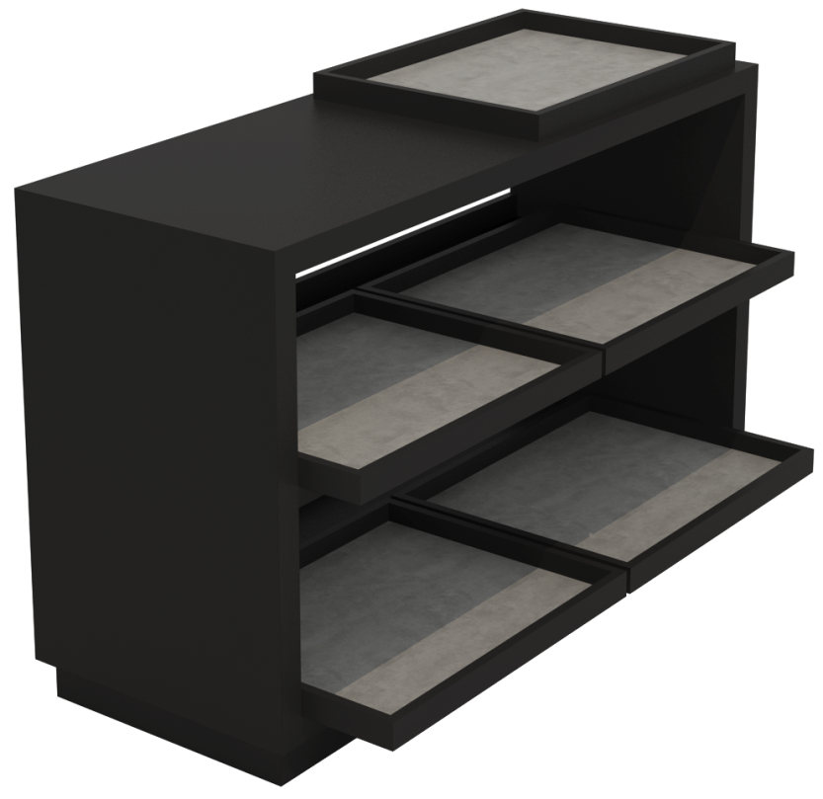
INTERIOR DESIGN PROPOSAL
03.
Interior Design Furniture
Counter
Sofa + Tea table
ACC Shelves
Showcase

Slide 19
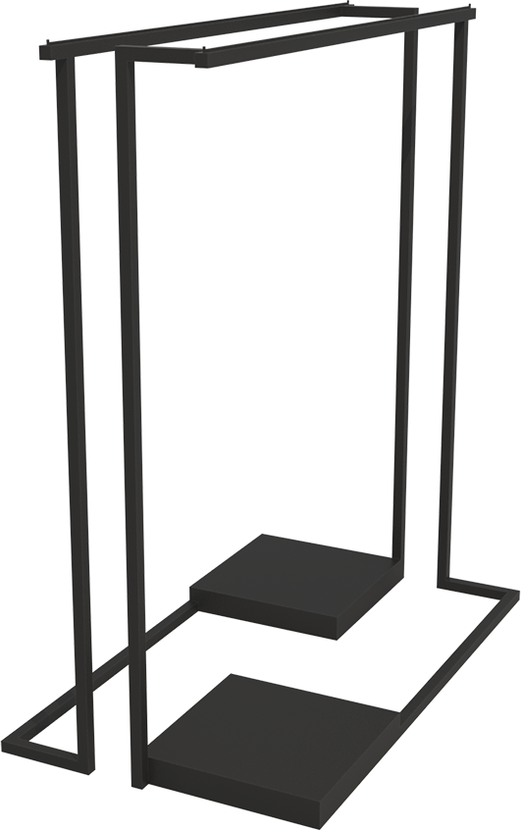
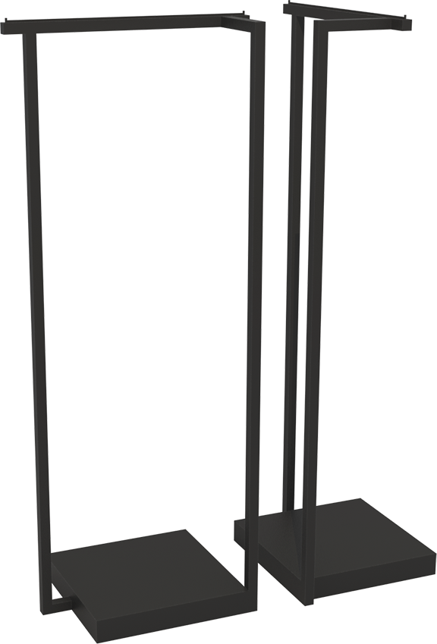
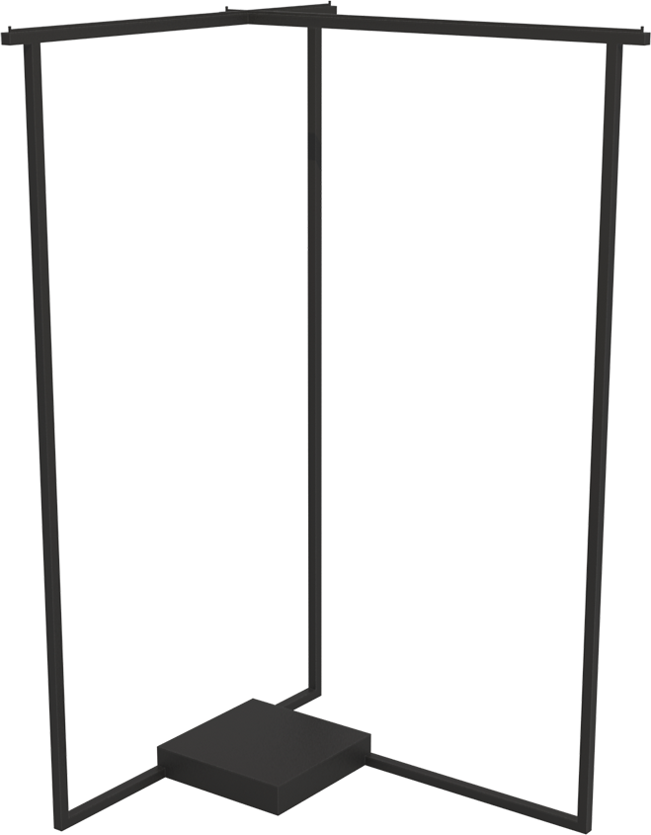
INTERIOR DESIGN PROPOSAL
03.
Interior Design Furniture
Single hanger
T hanger
2Way hanger

Slide 20


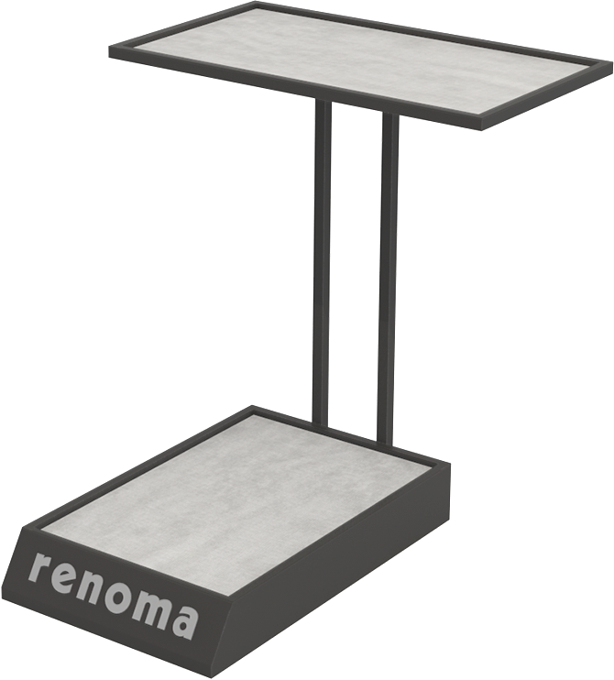
INTERIOR DESIGN PROPOSAL
03.
Interior Design Furniture
Single hanger
Shelves
Bag Shelves

Slide 21


INTERIOR DESIGN PROPOSAL
03.
Interior Design Furniture
Monitor Display Table

